Slide 1

hold the Control key, click the link, and download the entire templates right now, with a massive
60% OFF!
3000 Mind-Blowing Slides

Slide 2
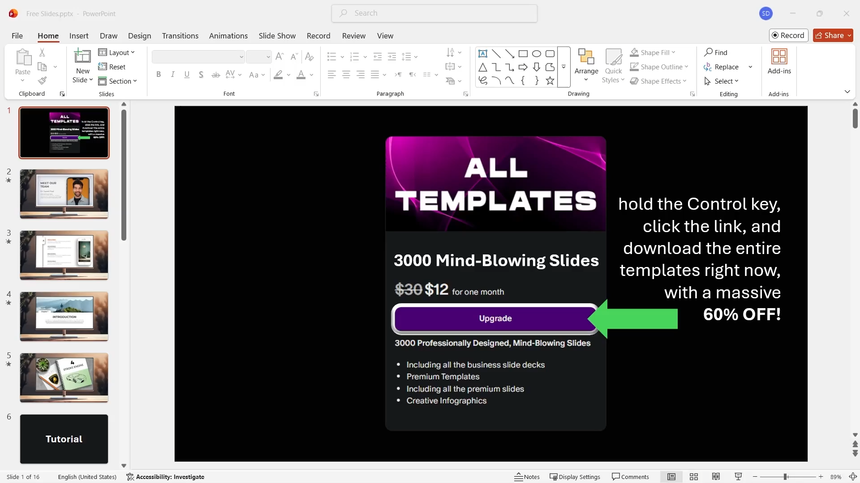
Watch this video to learn how to use the template

Slide 3
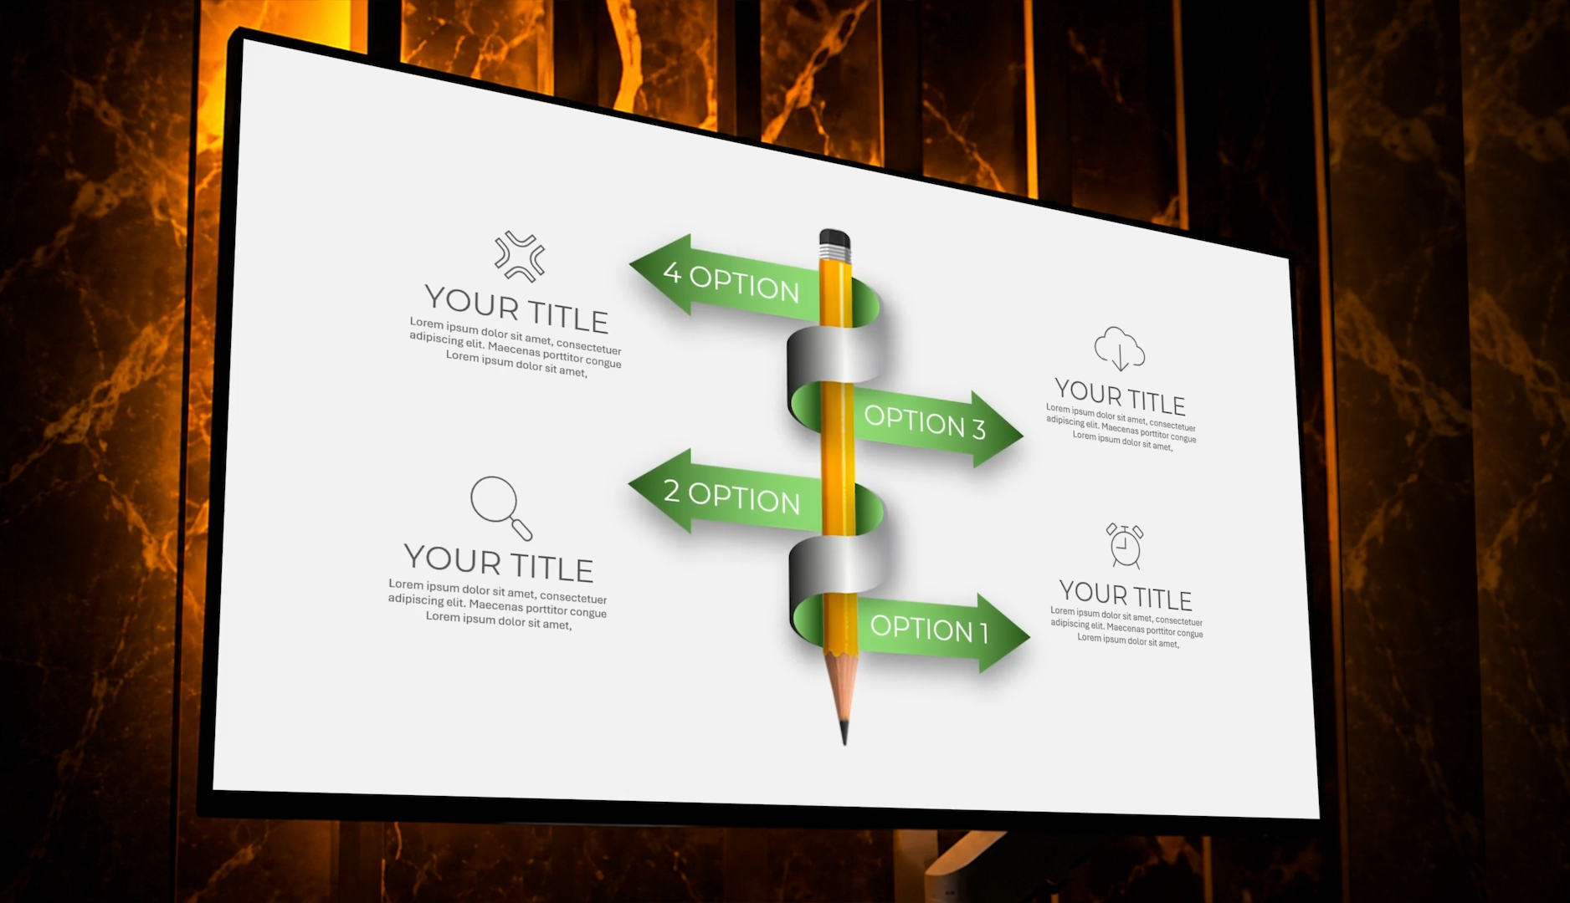
Play this video to see the most beautiful slides in the world

Slide 4
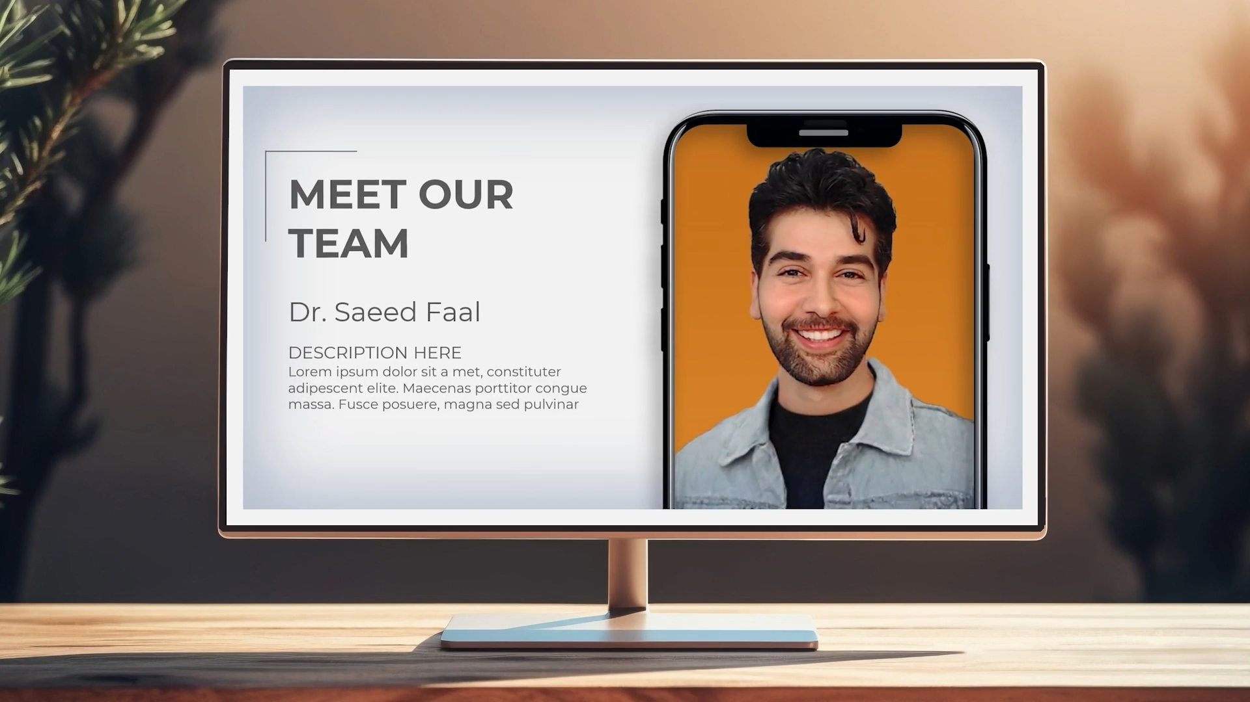
Pitch Deck Number 13 (140 Slides)

Slide 5
Please Watch The Second Slide To Learn How To Use This Template

Slide 6




Slide 7








Slide 8


Slide 10




Slide 12


