Slide 1
Watch Tutorials On My YouTube Channel
👇
https://www.youtube.com/channel/UCyznftKKSTDfJdH97pphHCg/

Slide 2
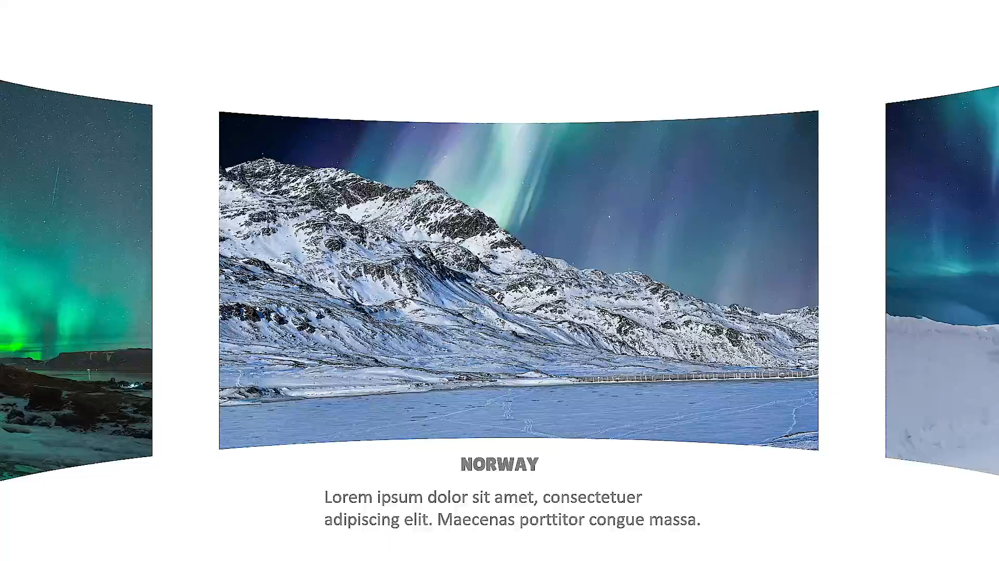

Slide 3
