Slide 1
Watch the full Tutorial On My YouTube Channel
👇
https://www.youtube.com/watch?v=SaJRXFsx_ZI
Font:
https://www.fontshare.com/fonts/general-sans
https://fonts.google.com/specimen/Lilita+One
https://befonts.com/objective-font-family.html

Slide 2
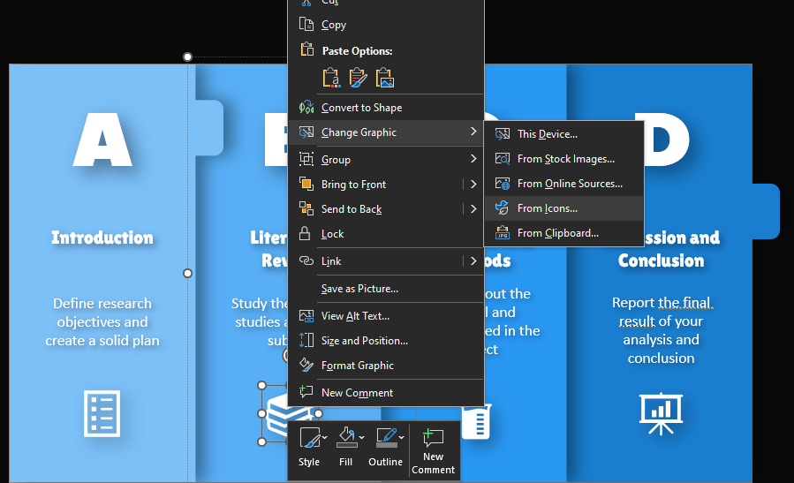
If you want to change icons don’t delete them. Right click on it and change it
2
3
1

Slide 3
FOUR CHAPTERS IN PROJECT

Slide 4




A
B
C
D
FOUR CHAPTERS IN PROJECT
Introduction
Literature Review
Materials and Methods
Discussion and Conclusion
Report the final result of your analysis and conclusion
Explain about the material and methods used in the project
Define research objectives and create a solid plan
Study the previous studies about the subject

Slide 5
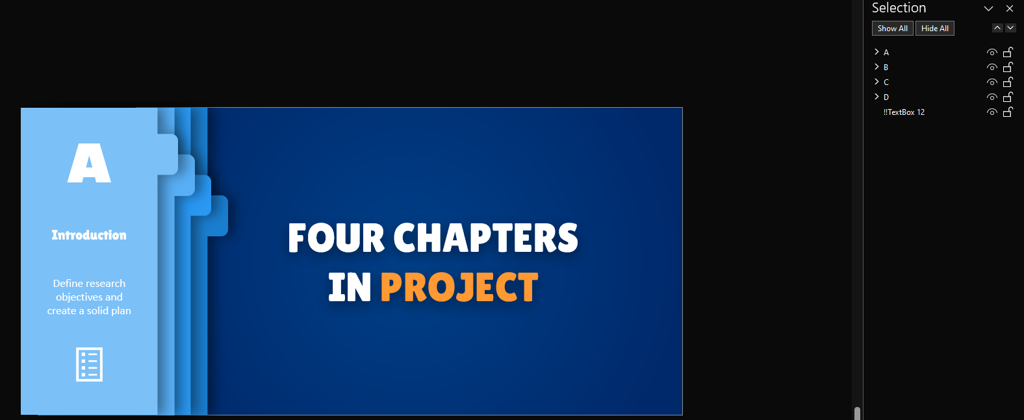
For editing this slide edit your content, then in the selection pane hide it to see the bellow shape and at the end unhide all of them (for activating the selection pane search it on search bar)
2
1

Slide 6
A
B
C
D
FOUR CHAPTERS IN PROJECT
Introduction
Literature Review
Materials and Methods
Discussion and Conclusion
Report the final result of your analysis and conclusion
Explain about the material and methods used in the project
Define research objectives and create a solid plan
Study the previous studies about the subject

