Slide 1

hold the Control key, click the link, and download the entire templates right now, with a massive
60% OFF!
3000 Mind-Blowing Slides

Slide 2
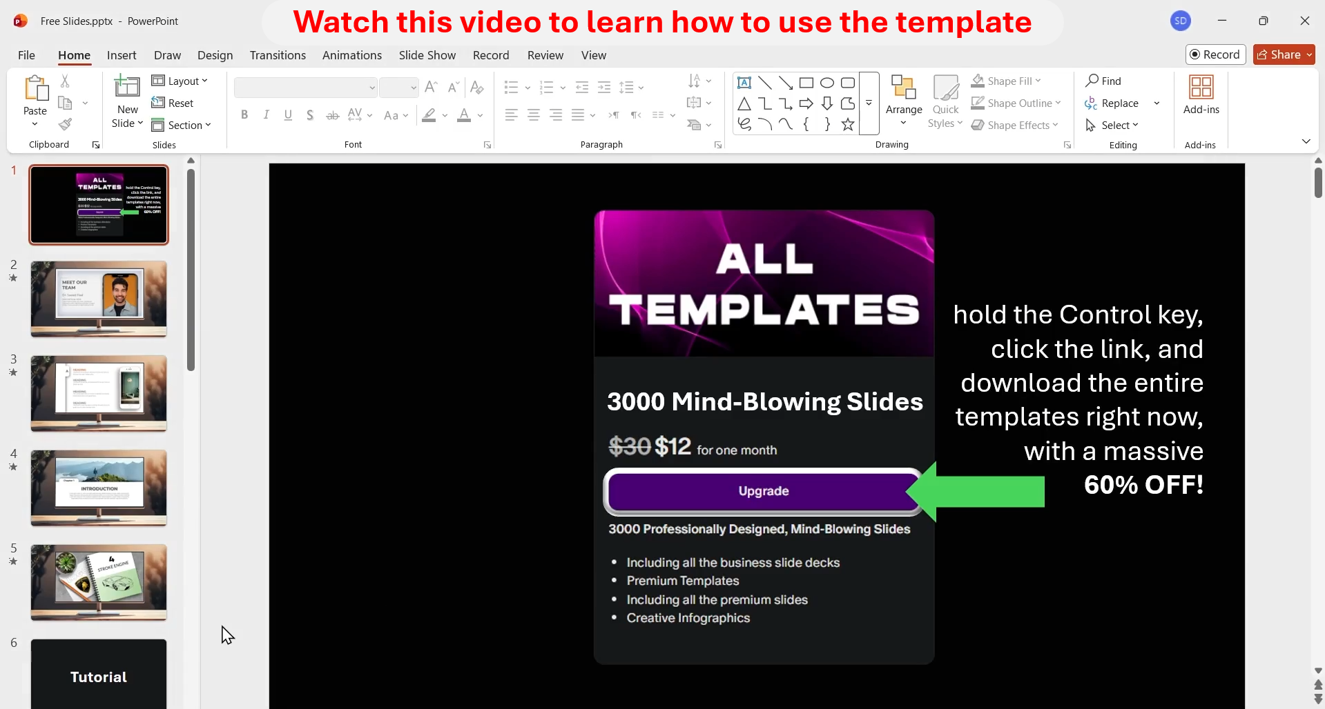
Watch this video it has special offer for you

Slide 3
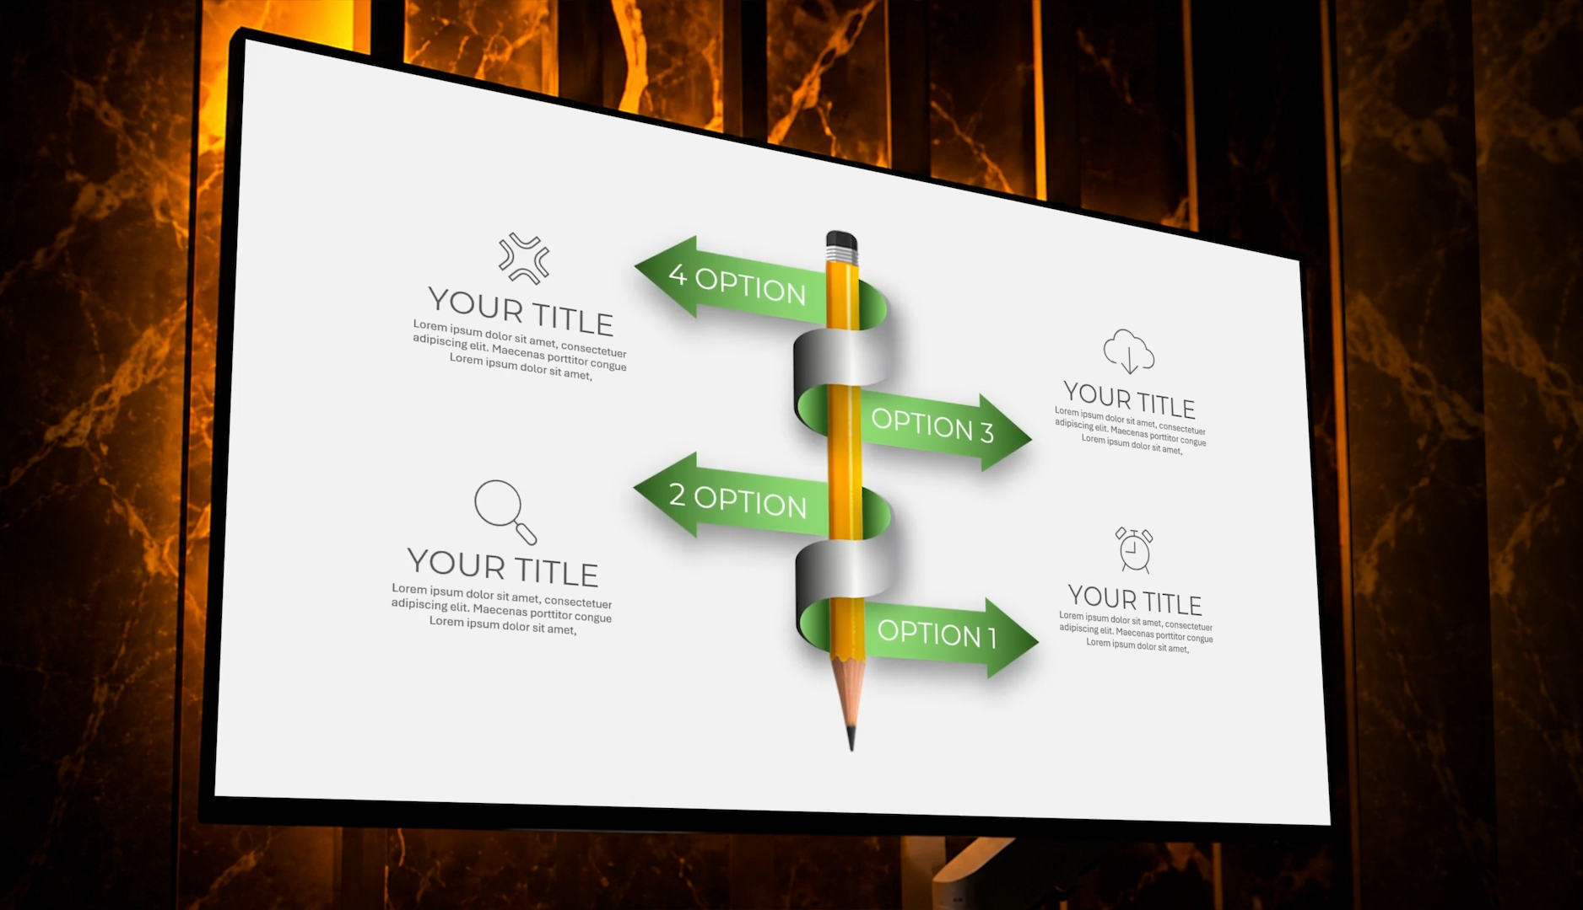
Play this video to see the most beautiful slides in the world

Slide 4
FOUR CHAPTERS IN PROJECT
1
2
3
4
Introduction
Literature Review
Materials and Methods
Discussion and Conclusion

Slide 5
FOUR CHAPTERS IN PROJECT
Materials and Methods
Discussion and Conclusion
Introduction
Literature Review
Define research objectives and create a solid plan

Slide 6
FOUR CHAPTERS IN PROJECT
Literature Review
Materials and Methods
Discussion and Conclusion
Introduction
Study the previous studies about the subject

Slide 7
FOUR CHAPTERS IN PROJECT
Discussion and Conclusion
Introduction
Literature Review
Materials and Methods
Explain about the material and methods used in the project

Slide 8
FOUR CHAPTERS IN PROJECT
Materials and Methods
Introduction
Literature Review
Discussion and Conclusion
Report the final result of your analysis and conclusion

