Slide 1
Masc V UV Body Tattoo Tutorial
Da da da daaaaaaa
Lets go! You’re gonna need Wolvenkit; that’s what I use ☺

Slide 2
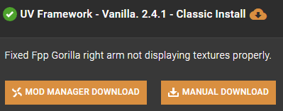
Step 1
First off, you’re gonna need to decide on which of the KS UV framework versions you want. I use:
You can have it at the bottom of your load order, as it is by default. But I have Fem V mods installed at the same time so I added a ! To put it at the top and it seems to work fine!
So go ahead and install that.

Slide 3
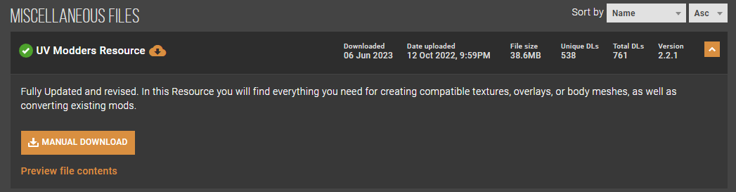
Step 2
Next, you’re gonna wanna grab the modders resources:
This is where you’ll find all the files you need for both Fem and Masc V!!!

Slide 4
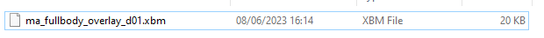
Step 3
For a Masc V body tattoo, you will need this:
And then you’ll need the overlay to draw on top of. It can be found in the files but if you get stuck, let me know. I can send them to you.

Slide 5
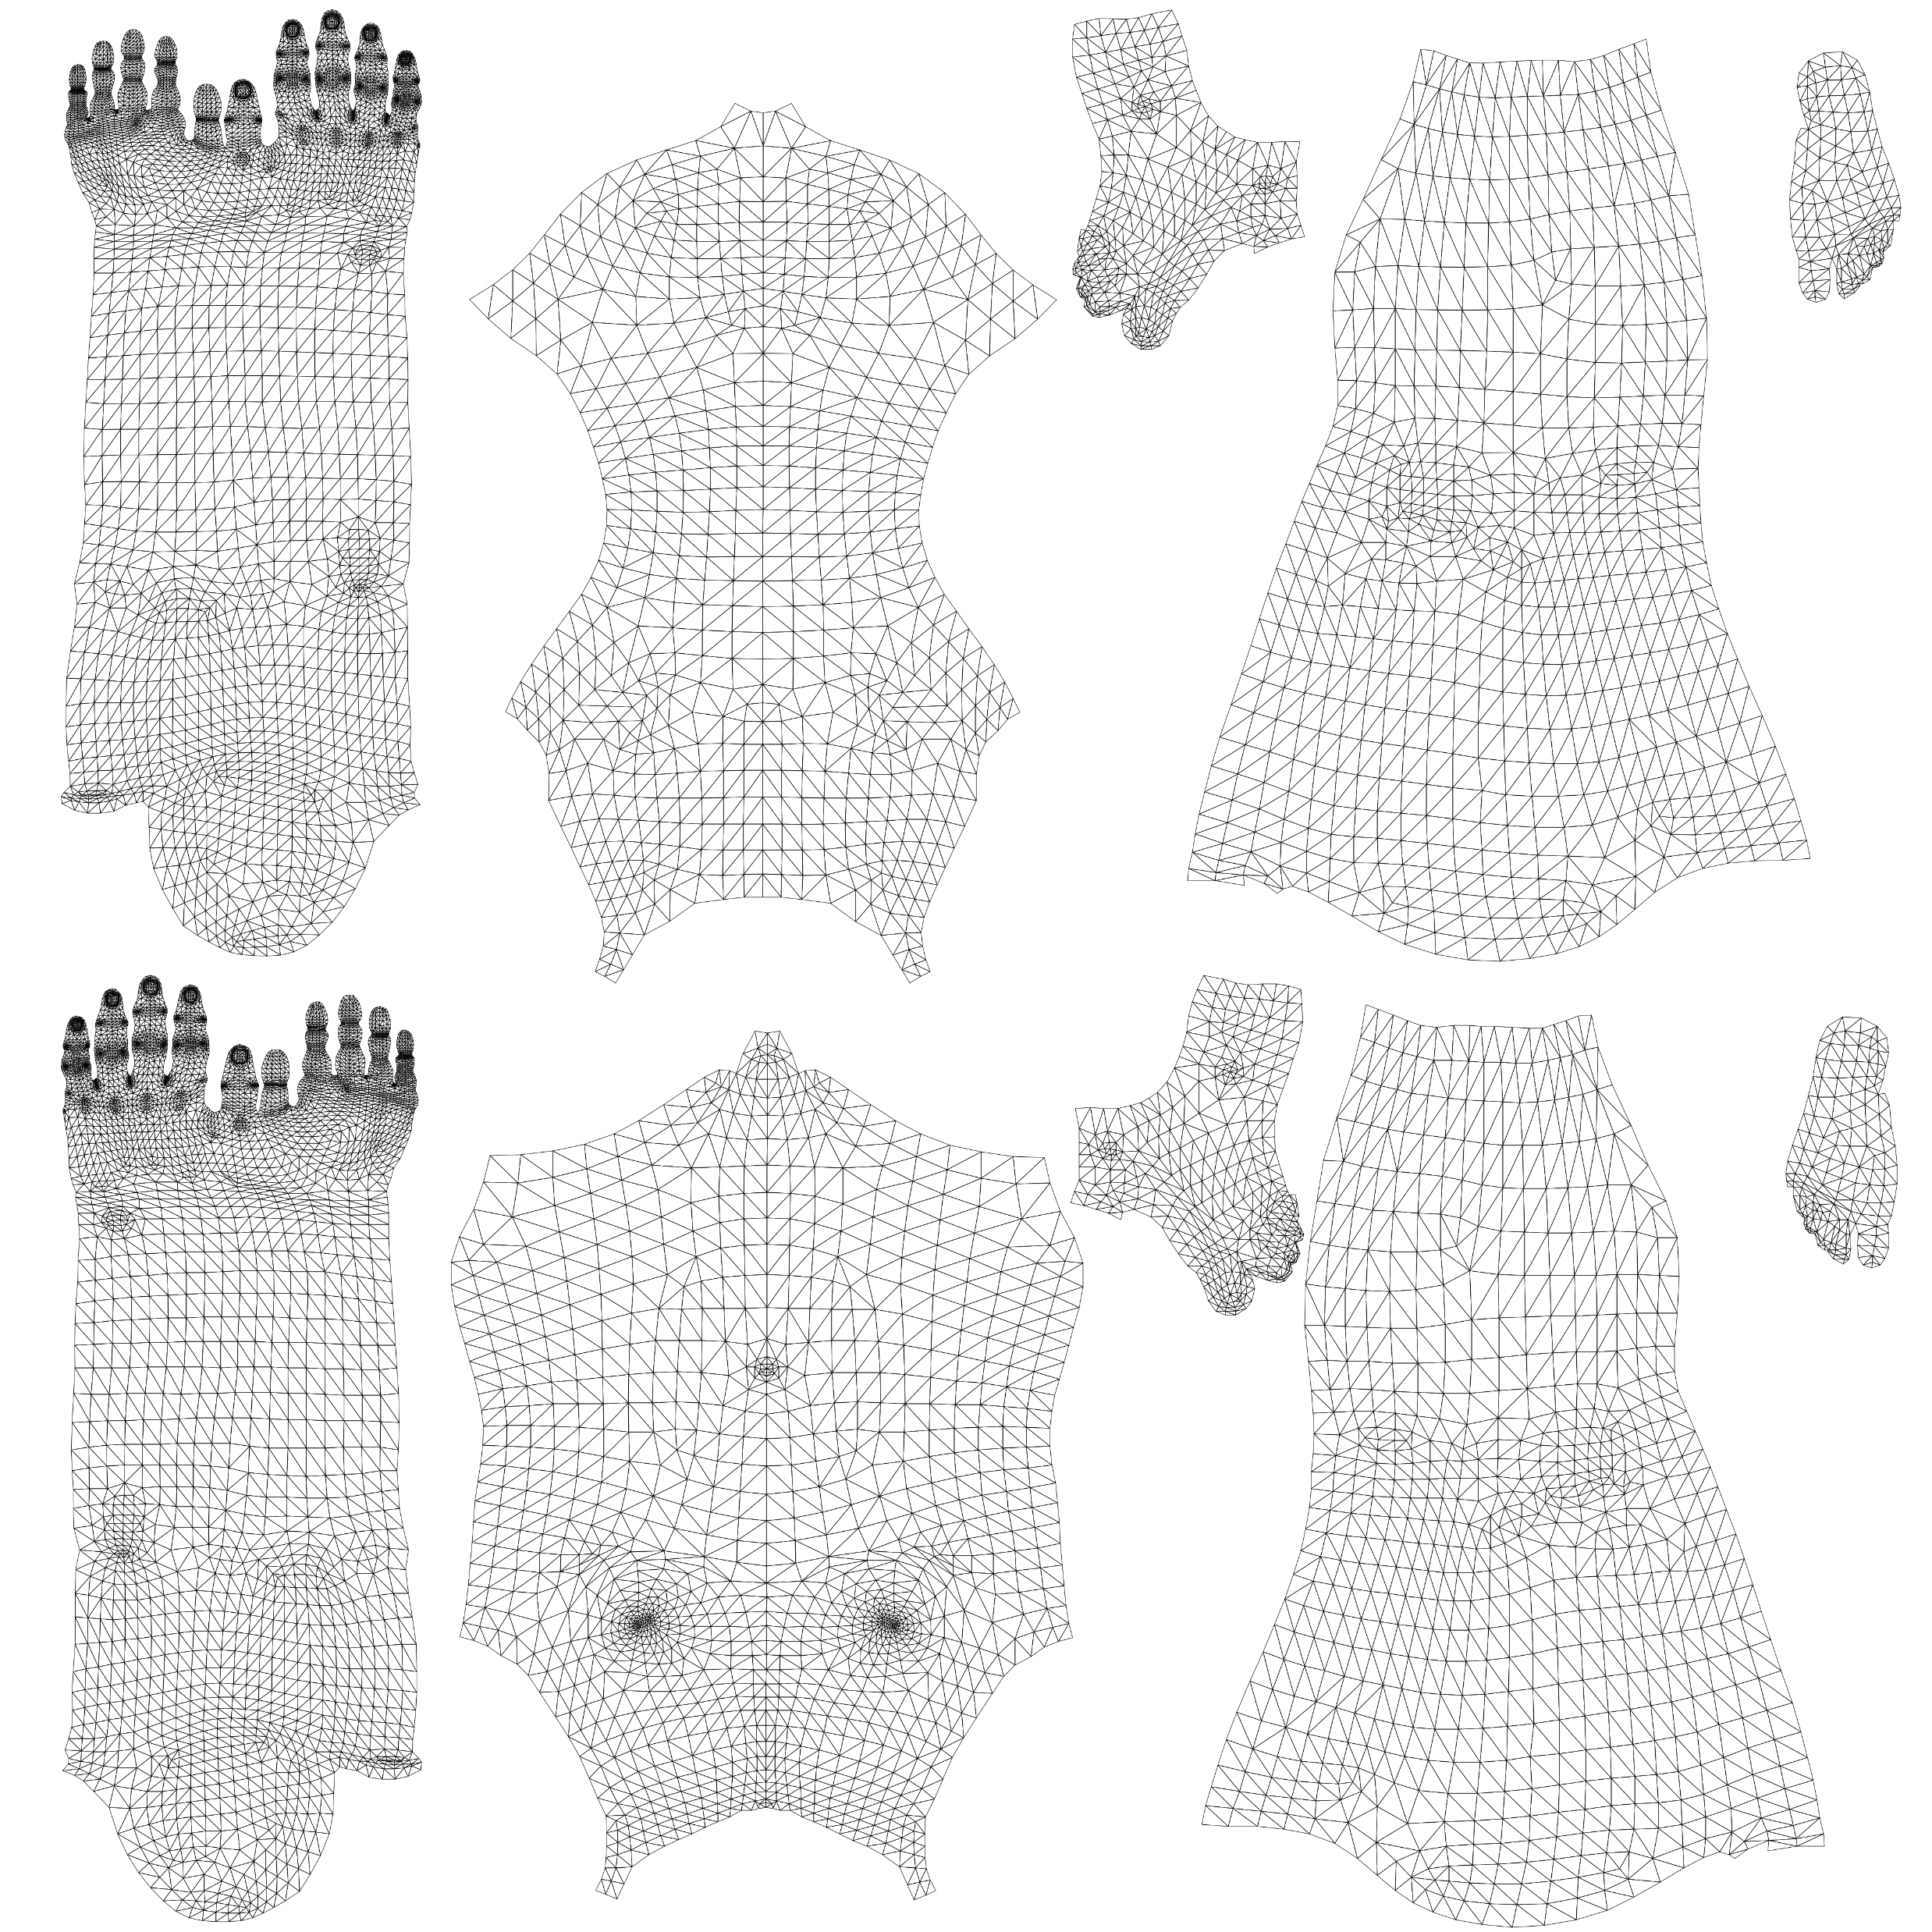
This is the UV texture for Masc V- fem looks identical!
I personally flip it upside down to look like this for easier placement:

Slide 6
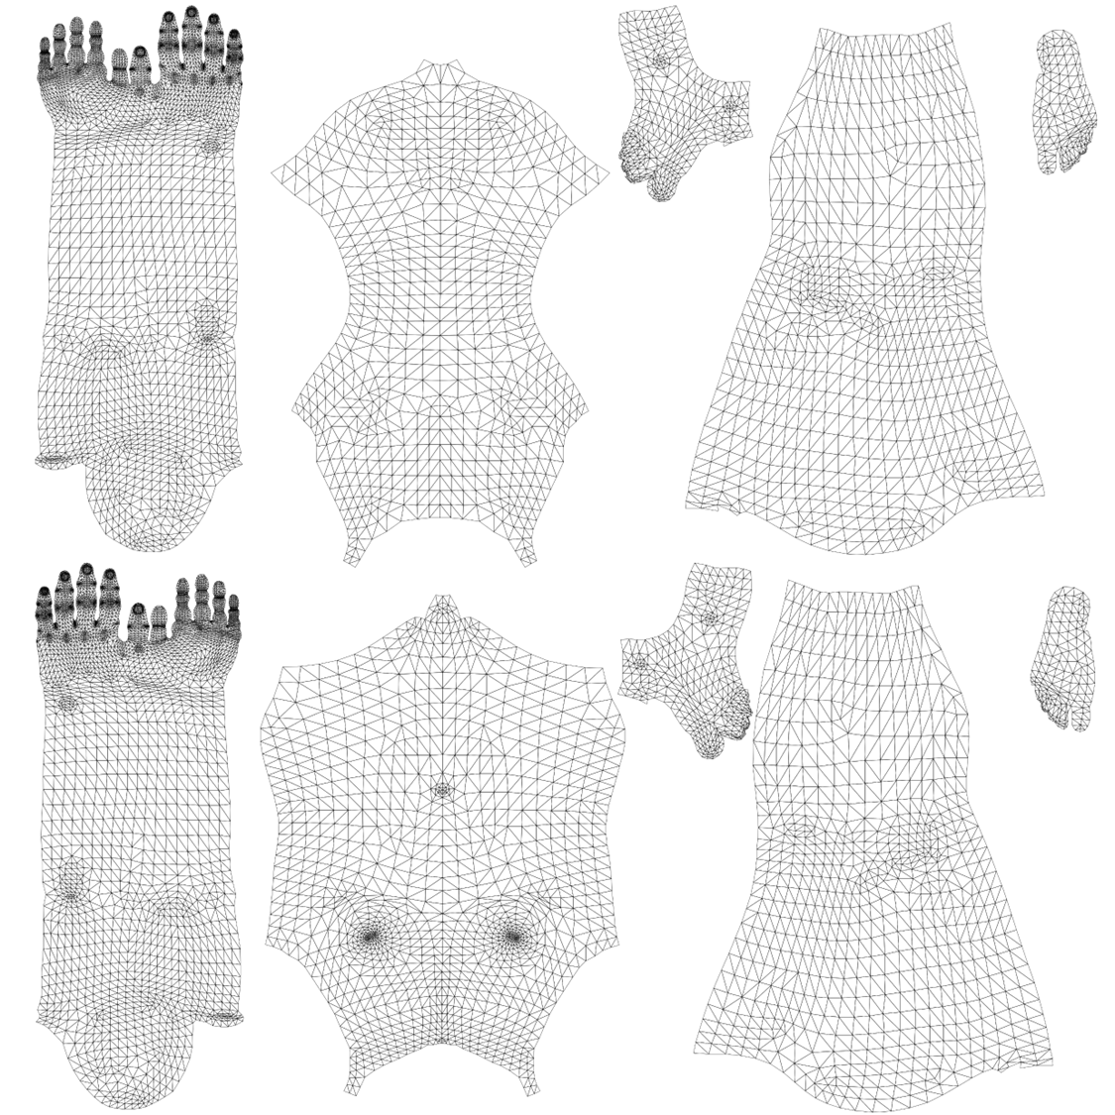
Right Arm
+ Wrist
+ Hand
Right Leg
+ Foot
Front
Back
Left Arm
+ Wrist
+ Hand
Left Leg
+ Foot

Slide 7
Step 4
Here’s where you design your tattoo.
I use Procreate personally (you will need to convert procreate pngs to wkit readable pngs, so let me know if that’s what you use)
What you wanna do is import the UV texture shown on the previous slide, and flip it upside down.
Lower the opacity of that UV png, and then create a new layer on top of it; this is where you will draw or place your tattoo; the UV map is a guide.
Once done, I recommend lowering the opacity of your design so it doesn’t appear solid black and looks a tad more realistic in-game.
Hide the UV guide and canvas background, so you can export the design itself as a png.

Slide 8
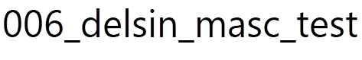
Step 5
With that file and your png tattoo, you can move on to the Wkit steps!!!
You need to open a new project in Wkit; I name mine stuff like:
The 006_ at the start should ensure the packed mod installs at the correct place in the load order. If it isn’t showing up, it’s safe to add a ! To the start of the file ☺

Slide 9
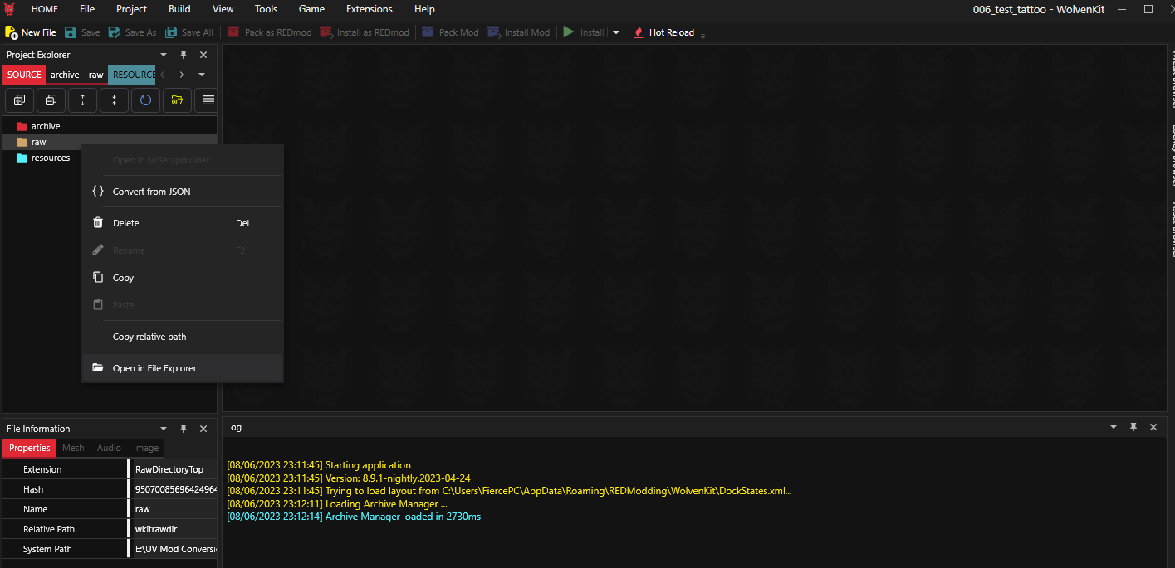
Step 6
Ok. You’re in Wolvenkit. You want to right click on raw, and then click this:

Slide 10
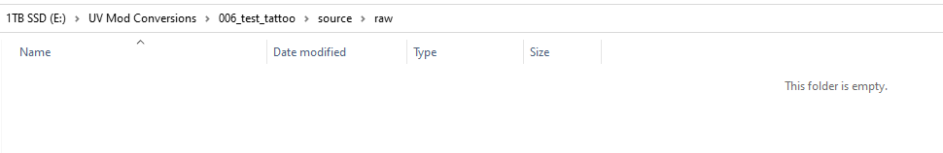


Step 7
That opens the raw file and folders:
Big step now :D You’re gonna wanna create a string of folders in here. Here is the correct file path:
You can then copy the ‘base’ folder from inside that raw folder, into:

Slide 11
Step 8
Okay, you should now have the same file path in both the raw and archive folders.
Now, you wanna first grab this file from earlier:
And drop it in the final folder in the archive file path:

Slide 12
Step 9
Now that you’ve done that, grab your tattoo png and drop it in the final folder of the raw file path:
Next, go back to the final archive folder. See the xbm file? Choose the rename option, and just copy (not delete!!!) the file name;
ma_fullbody_overlay_d01
Then go back to your tattoo png, choose rename, and delete whatever you named that png as; replacing it with:
ma_fullbody_overlay_d01

Slide 13
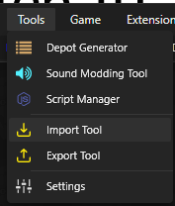
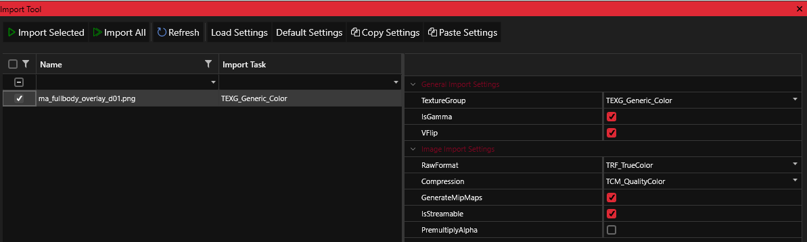
Step 10
Now, you’re gonna want to head back into Wolvenkit, check the file paths are right- and choose this option:
You’re gonna want to click import, and this is what should show up; make sure to check all these options:

Slide 14
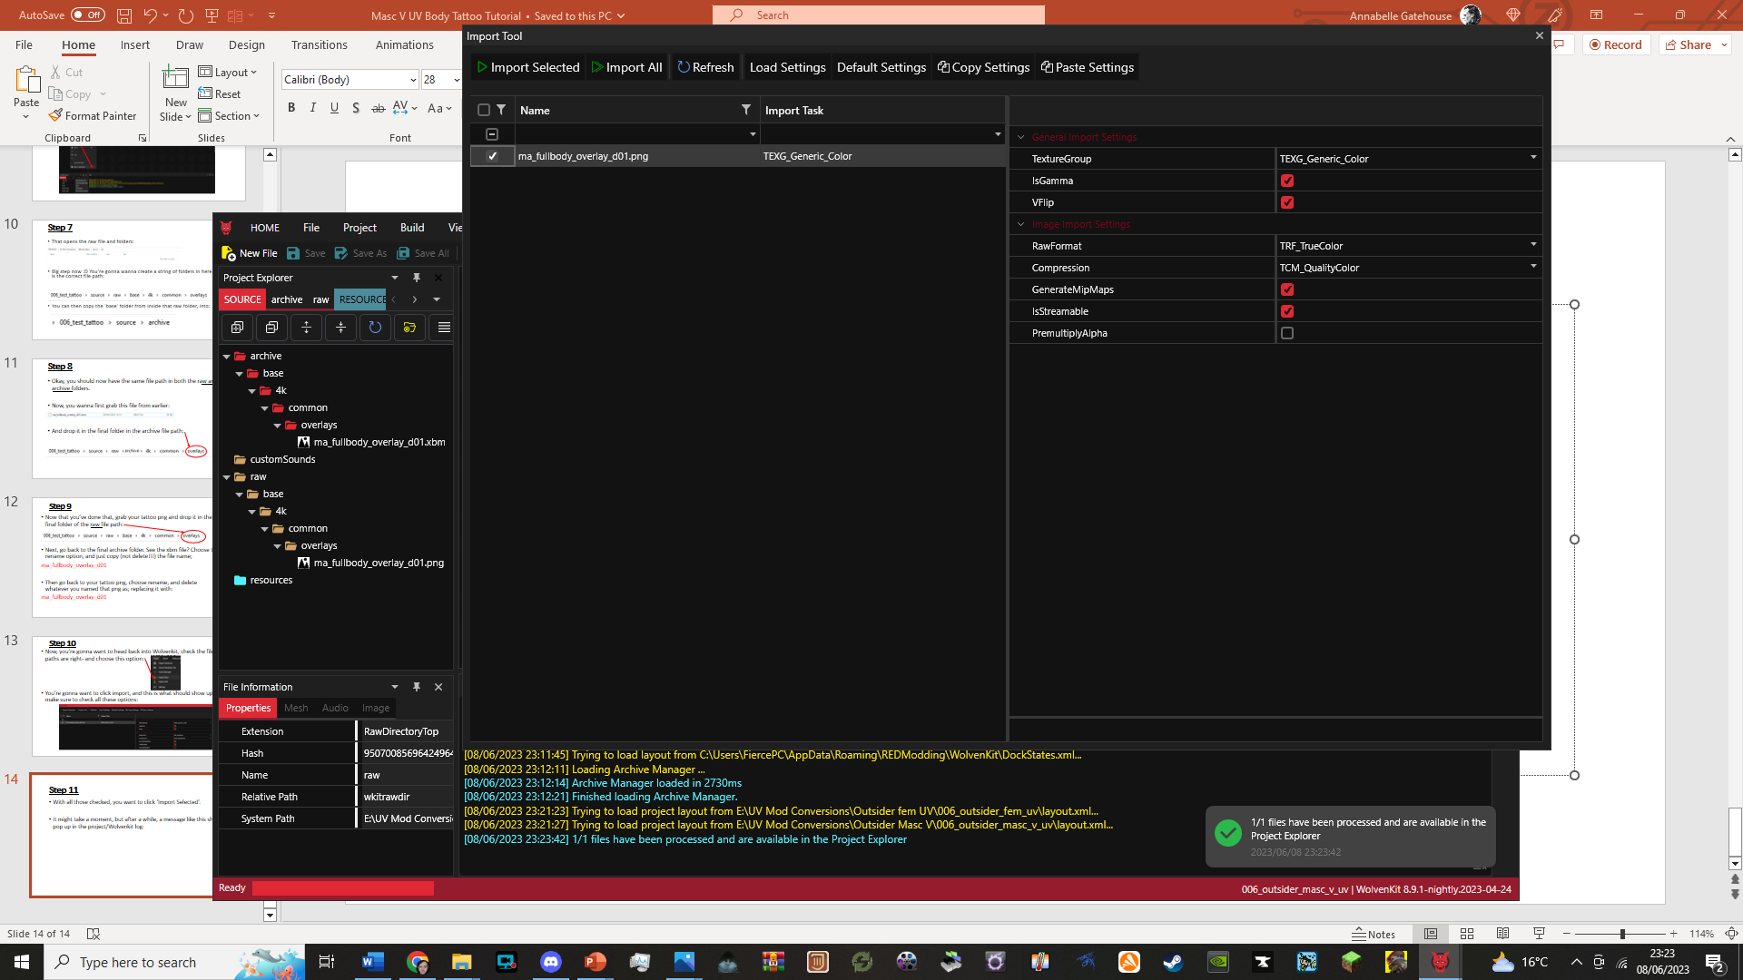
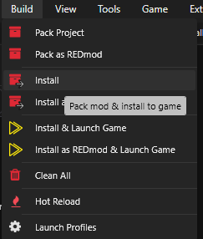
Step 11
With all those checked, you want to click ‘Import Selected’.
It might take a moment, but after a while, a message like this should pop up in the project/Wolvenkit log:
After that, you’re gonna want to hit this option; it’s what I’ve always used and it seems to work fine:

Slide 15
Step 12
It should now be installed in your game; remember it may take a moment.
Close Wolvenkit for now, and launch the game.
The tattoo should just show up on your V as soon as you go into the character creator, a built in tattoo overlay!

