Slide 1
Watch The Full Tutorial On My YouTube Channel
👇
https://www.youtube.com/watch?v=QDBHvY-qQhY
Use Link Below To Download Background Image
👇
https://www.freepik.com/free-photo/workplace-with-smartphone-coffee-cup-notebook-black-table-top-view-background_7760398.htm
Learn How To Design Overlapped Text Effect
👇
https://www.youtube.com/watch?v=-hmbycbiVNc

Slide 2
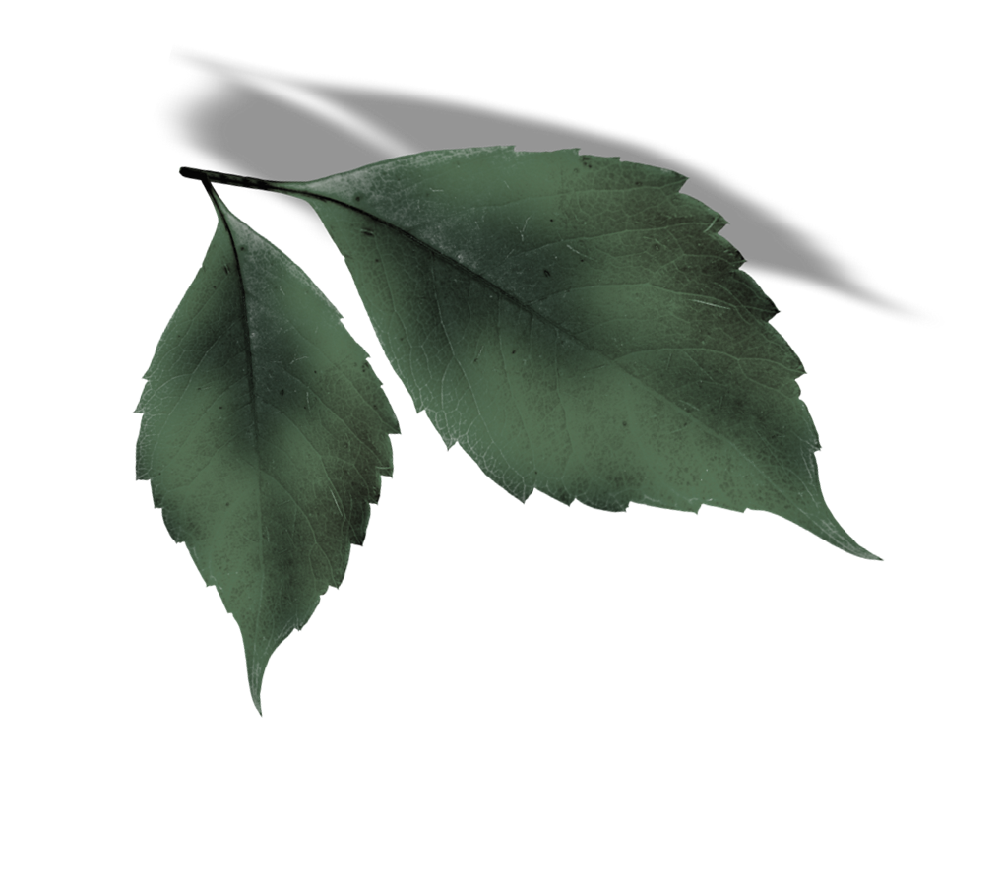
L
E
A
V
E
S

Slide 3
Art and Flowers In the Garden
Art and flowers have a long-standing relationship, as artists have been drawn to the beauty and symbolism of flowers for centuries. From ancient Egyptian frescoes to contemporary paintings, flowers have been a popular subject matter for artists across various mediums. Flowers have been used to convey a range of emotions, from love and joy to sadness and mourning.

Slide 4
Art and Flowers: An Overview
Art and flowers have been intertwined for centuries, with artists finding inspiration in the beauty and symbolism of flowers. From ancient Egyptian wall paintings to modern-day still-life paintings, flowers have been a popular subject in art.

Slide 5
Historical Context of Art and Flowers
During the Renaissance period, flowers were often depicted in paintings as symbols of love, purity, and beauty. The use of flowers in art was also influenced by the development of botanical studies, which led to a greater understanding of the natural world and the importance of plants.

