Slide 1
How to Make a VTK Tattoo
By MeltingAngels
Thanks to Bedellia and Edith who helped me learn.

Slide 2
What you need!
You need a drawing or editing software to draw/design your tattoos; I personally use Procreate on my iPad.
Wolvenkit- this is what I use.
(You should be able to find a guide on how to install)
VTK resources
(Don’t worry, we’ll go over that)
Legitimate copy of Cyberpunk 2077.

Slide 3
Step 1 - Resources
First off, you’re gonna need to head over to the VTK page, and grab the Modding Resources + Head Resources from the Miscellaneous Files.
(I recommend saving these to a proper folder for easy access)
On the VTK page is a link, which directs you to where you can get the overlays you need:
https://xbaebsae.jimdofree.com/cyberpunk-2077-tutorials/cp2077-hd-feet-body-textures
The head overlay isn’t as easy to grab, if you can’t find it let me know, and I will gladly send it over to you.

Slide 4
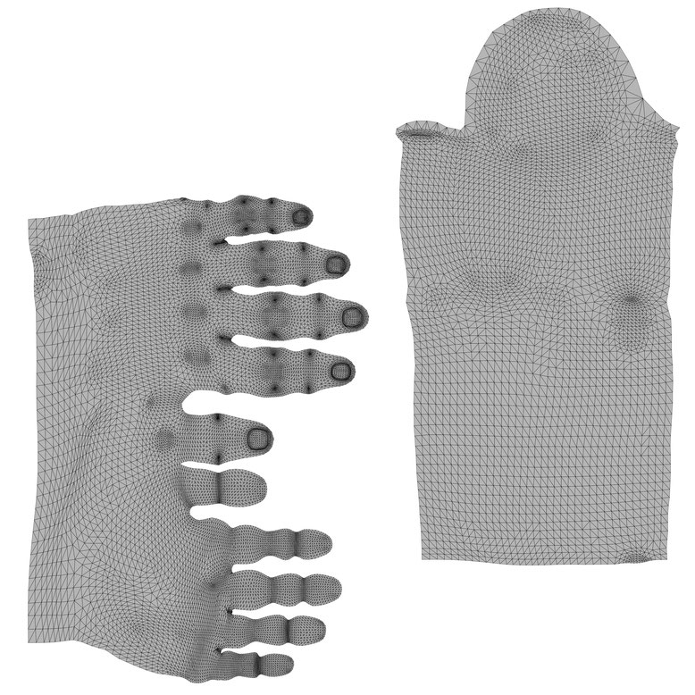
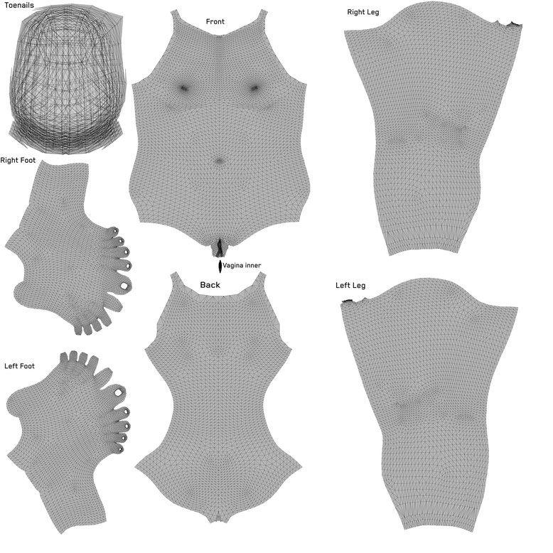
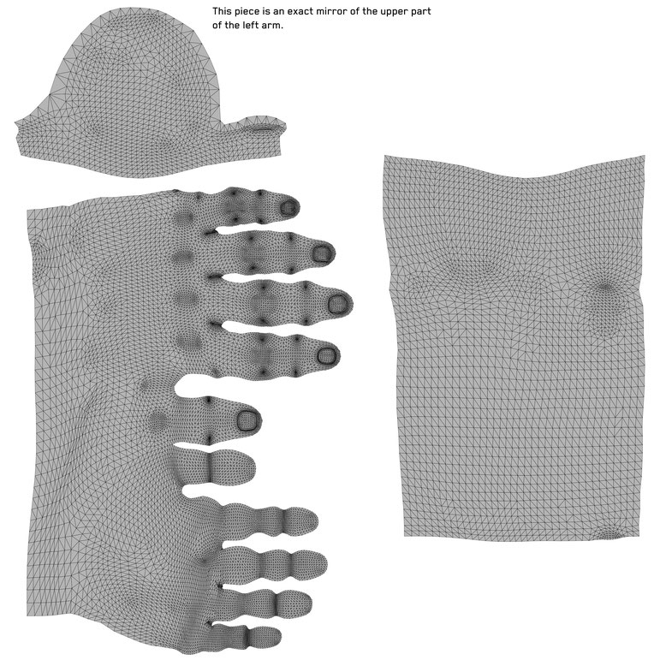
The Overlays:
Left Arm
Body + Legs
Right Arm

Slide 5
Step 2 - Design
Now, I use Procreate on my iPad to draw my designs; what you use is entirely up to you- you just need to follow these steps.
You’re gonna want to import the body textures into your drawing or editing software. They should be at 4096x4096.
Make the textures semi transparent, then make a new layer on top of the textures- that is what you draw on.

Slide 6
Step 3 - Exporting
Once you’re done designing, I recommend lowering the opacity of your tattoos to around 85%- solid black does not look good in-game.
For the arm tattoos, you may need to flip them before popping them into the wkit project; I did with my right arm tattoos. However it’s been a while since I started a VTK tattoo from scratch, so cannot honestly remember- but don’t worry.
Make sure you hide the textures and background of your canvas; you just want to export your design as a png. This is what works in WolvenKit.

Slide 7
Step 4 – Project
Now, here’s where things get a little bit more complicated. But don’t worry, it’s easy to grasp; just a kinda tedious process at times! It is worth it though.
You want to open up Wolvenkit and start a new project. Name it something like 00_first_tattoo. Keep this project open for now, do not close it.
(Wolvenkit doesn’t like capital letters, and the 00_ at the start ensures it will install at the right place in your load order)
I recommend creating a dedicated folder for your tattoo mods, so your projects and such are easy to access.

Slide 8
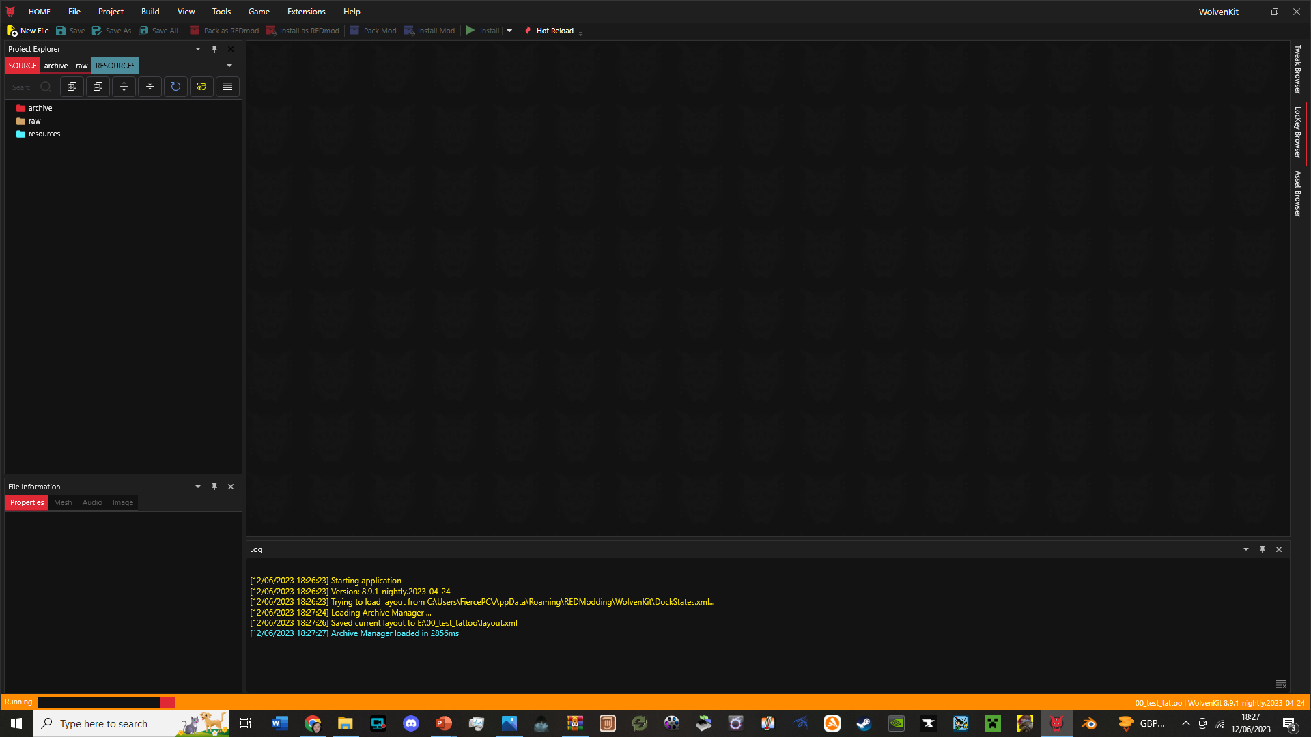
Step 5 – Folders and Pathing
Alright, you should start with something like this:

Slide 9
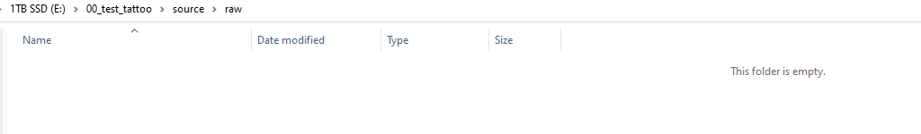
Step 5 Continued
You want to go over to the raw folder, right click, and select ‘Open in File Explorer’.
This will open up the folders on your PC, outside of Wolvenkit, and looks like this to begin with:

Slide 10
Step 5 Continued
Now, you want to create these folders from the Raw folder. Do not use capital letters, name them exactly as I have. Follow these paths.
raw-base-v_textures-body
(For body and leg/foot tattoos)
raw-base-characters-head-player_base_heads-player_female_average-h0_000_pwa_c__basehead-textures
(For head and neck tattoos)
raw-base-characters-player-femme-body-arms-textures
(For arm tattoos)
The next step is easy; just go back to the raw folder. Copy the ‘base’ folder, then head over to source-archive. Paste the ‘base’ folder in there; this way the paths are identical for both the ‘raw’ and ‘archive’ folder paths.

Slide 11
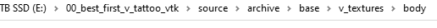
Step 6 – What files go where?
Now, you should be left with empty folders in these kinda paths:
In both the ‘raw’ and ‘archive’ folder paths.
First, head to the very end of the archive folder path. Keep this open.
Grab the relevant files from the Modding and Head resources:
v_overlay.xbm (File needed for Body/Leg Tattoos)
femme_arm_right_01_overlay.xbm (For Right Arm Tattoo)
femme_arm_left_01_overlay.xbm (For Left Arm Tattoo)
h0_001_pwa_c__basehead_overlay.xbm (For Head/Neck Tattoos)

Slide 12
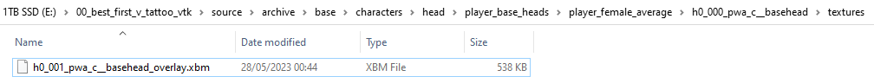

Step 6 Continued – What files go where?
You want to put those .xbm files in the end of the ‘archive’ folder path.
For example, for the head tattoo, you’d put the h0_001_pwa_c__basehead_overlay.xbm file in this folder, at the end of this file path:
Then you wanna go back to the ‘raw’ folder path. You want to put your png file at the end of that file path. For example, you’d put your head/neck tattoo png here:
Your png

Slide 13
Step 7 – Renaming PNGs
Now that the .xbm file or files are in the end of their respective ‘archive’ file paths, and the png files are at the end of their respective ‘raw’ file paths, you want to go to the .xbm file.
Click ‘rename’ and copy that name. It won’t copy the .xbm bit as that’s the file type; this is correct. DO NOT DELETE OR RENAME THE XBM FILE; YOU JUST WANT THE FILE NAME.
Go to your png in the raw folders now. Click rename, and paste the name you grabbed from the .xbm file. THEN PRESS ENTER. YOU WANT TO RENAME THE PNGS.

Slide 14
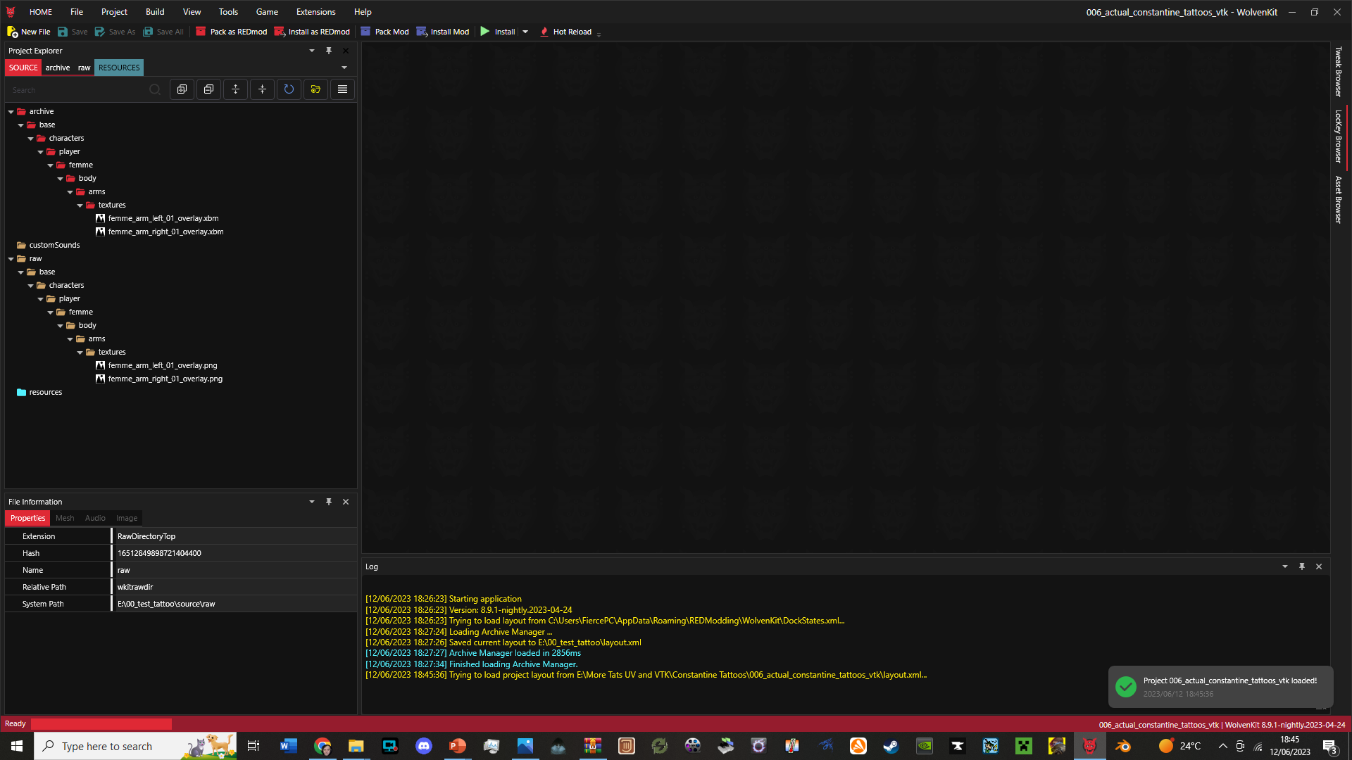
Step 8 – Wolvenkit
When all that is said and done, head back over to your Wolvenkit project. It should look something like this (this is one of my tattoos, for example):
File structure should look similar to this!
Make sure your log is visible. If it isn’t, click on the ‘View’ tab at the top of Wolvenkit, and select ‘Log’.

Slide 15
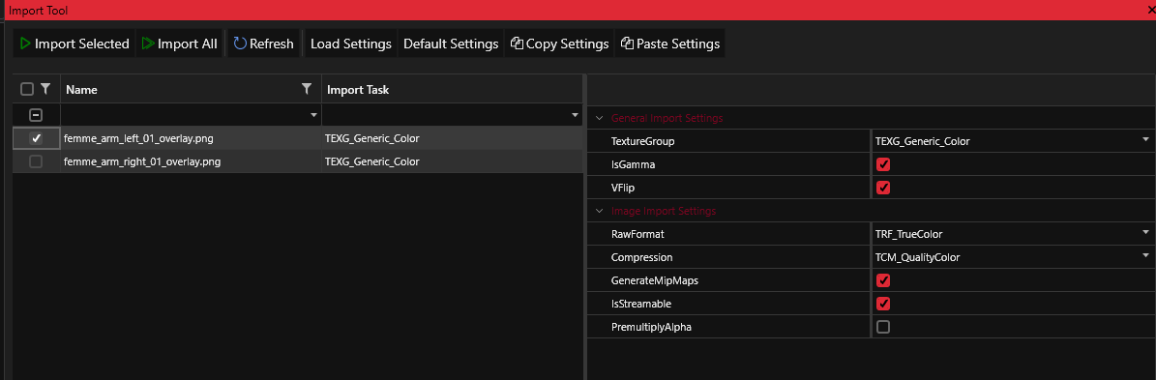
Step 9 - Importing
Now, head over to the ‘Tool’ tab at the top in Wolvenkit.
Click ‘Import’, and a window like this should come up:
Keep these boxes ticked.
Click the png and choose ‘Import Selected’ if it’s just the one tattoo, or ‘Import All’ if you are doing…both arms, for example; like you see here.

Slide 16
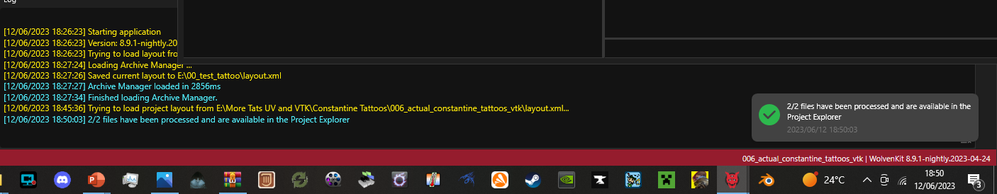
Step 10 – Processing Files
In your log, once your pngs have processed, you should see a message like this:
Once this happens, you can safely close the ‘Import’ window.

Slide 17
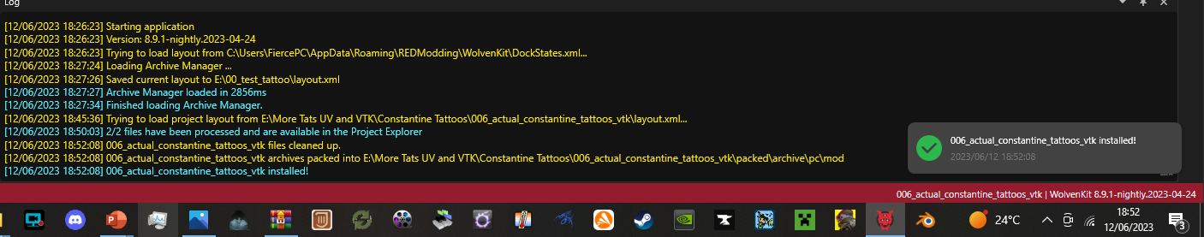
Step 11 - Installation
Great, your pngs are all available. You may be wondering what the .xbm files are for. Those are the actual VTK texture files; without those in the ‘archive’ folders, the pngs will not show up right, if at all.
Right, you want to go over to the ‘Build’ tab at the top and click ‘Install’. This is personally what I use.
After a moment, this message should pop up.

Slide 18
Step 12 – Checking In-Game
You can now safely close Wolvenkit.
Launch your game, and your tattoos should be visible right from the character creator.
If your arms are flipped the wrong way, you will need to uninstall your mod, and go back to your files in your drawing/editing software; then flip those designs horizontally.
After, you will need to pop those where the original pngs got put.
Then you will need to grab the name of the original png, named the same as the .xbm file, and then delete that original png. Give the .xbm name to the new png. You will then need to go through the import and installation process again.

Slide 19
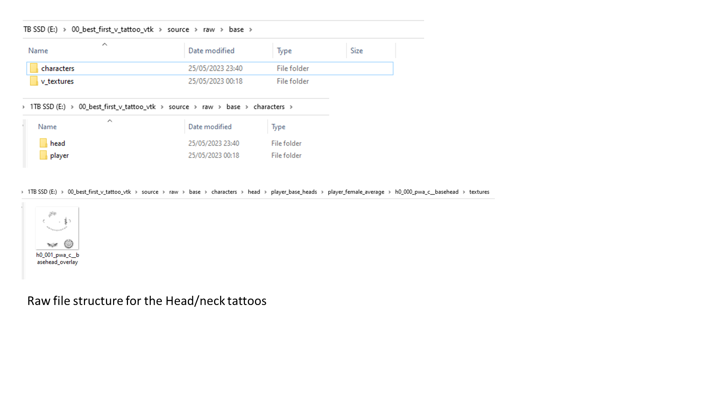

Slide 20
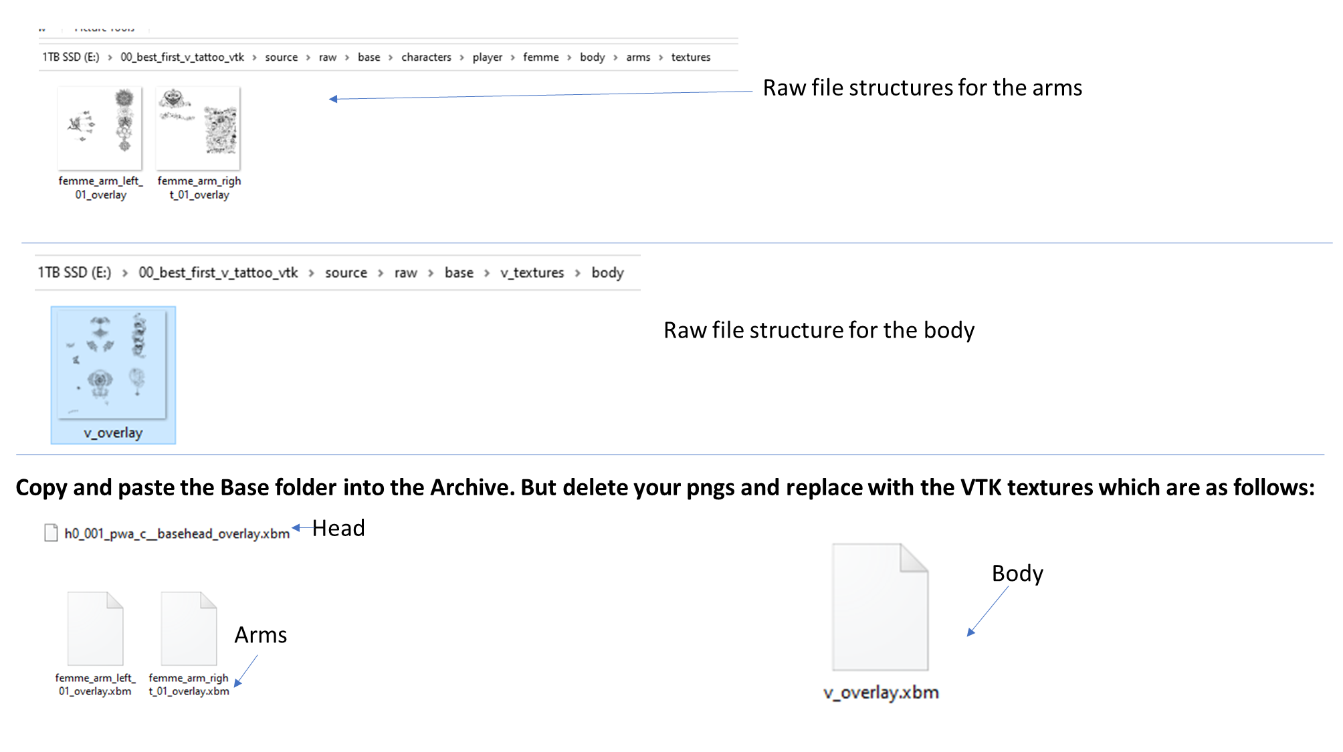

Slide 21
How to Make a VTK Tattoo
That’s all you should need to know.
If you have issues finding the textures to draw on, feel free to send me a message.

